Slide 1


HHH – THE RIDE APP
a Kings of code software package
Tim Haxton, Cooper wolf (Lead), Jon scales
Iteration 2

Slide 2
Current state of business (1)
No mobile app exist for HHH
Registration done through 3rd party
BikeReg.com
HHH information available via website: www.hh100.org

Slide 3
Goals of our system (1)
Meet needs of potential participants
Registration portal with easily accessible, user-friendly, intuitive GUI
Provide streamlined on-site registration
Provide weekend event schedules & local information (dining, lodging, etc)
Meet needs of HHH volunteers and administration
Intuitive GUI for on-site registration volunteers to take participant payment and assign rider numbers
Seamless integration of pre-existing BikeReg.com participant database into on-site registrant database
Intuitive interface to allow HHH admin to access participant information in cases of medical or safety emergencies.
(Stuff in red might be listed separately on needs slides)

Slide 4
Wish List 1: Desired program features
Streamlined data entry for on site participant registration
Database of participant information accessible by HHH admin
Seamless integration of BikeReg participant database with THE RIDE APP database
At-A-Glance HHH weekend event information for app users

Slide 5
Wish List 2: Desired program features
Streamlined data entry for on site participant registration
Database of participant information accessible by HHH admin
Seamless integration of BikeReg participant database with THE RIDE APP database
At-A-Glance HHH weekend event information for app users

Slide 6
Wish List 3: Desired program features
Streamlined data entry for on site participant registration
Database of participant information accessible by HHH admin
Seamless integration of BikeReg participant database with THE RIDE APP database
At-A-Glance HHH weekend event information for app users

Slide 7
Wish List 4: Desired program features
Streamlined data entry for on site participant registration
Database of participant information accessible by HHH admin
Seamless integration of BikeReg participant database with THE RIDE APP database
At-A-Glance HHH weekend event information for app users

Slide 8
Needs 1:

Slide 9
Needs 2:

Slide 10
Needs 3:

Slide 11
Needs 4:

Slide 12
Functional Requirements 1: All USERS
The application shall provide pages for the HHH weekend events schedule & planner
The application shall provide pages for the HHH tradeshow vender list & map
The application shall provide pages for the HHH routes map & tracker
The application shall provide local information guide links to participants
The application shall provide links to HHH social media to participants

Slide 13
Functional Requirements 2: participant side
The application shall allow participants to register for any event on the day of the event
The application shall allow participants to make a SAG assistance request
The application shall restrict participants’ access to HHH-side admin data

Slide 14
functional Requirements 3: HHH side
The application shall provide access to the on-site registration database
The application shall provide assignment of rider numbers
The application shall provide SAG request response with rider location info
The application shall provide HHH weekend event schedule
The application shall provide tiered levels of administrative access to HHH-side volunteers

Slide 15
Functional Requirements 4:

Slide 16
functional Requirements 5:

Slide 17
functional Requirements 6:

Slide 18
Non-functional Requirements 1:

Slide 19
Non-functional Requirements 2:

Slide 20
Non-functional Requirements 3:

Slide 21
Non-functional Requirements 4:

Slide 22
Non-functional Requirements 5:

Slide 23
Non-functional Requirements 6:

Slide 24
CONSTRAINTS 1: front end
Frontend restricted to JavaScript, Python, or Django

Slide 25
CONSTRAINTS 2: front end
Frontend restricted to JavaScript, Python, or Django

Slide 26
CONSTRAINTS 3: api
FastAPI

Slide 27
CONSTRAINTS 4: api
FastAPI

Slide 28
CONSTRAINTS 5: backend
Backend restricted to C++, Python, or Java

Slide 29
CONSTRAINTS 6: backend
Backend restricted to C++, Python, or Java

Slide 30
CONSTRAINTS 7: database
Database restricted to SQL

Slide 31
CONSTRAINTS 8: database
Database restricted to SQL

Slide 32
Derivation of requirements
Technique 1…….
Technique 2….
Technique 3…..
Technique 4…..

Slide 33
Derivation of requriements
Technique 1 usage…….

Slide 34
Derivation of requriements
Technique 2 usage…….

Slide 35
Derivation of requriements
Technique 3 usage…….
Technique 4 usage…….

Slide 36
Next 8 slides answer questions

Slide 37

What is the HHH Organization
What
Current situation
How does it operate

Slide 38
System Context

Slide 39
Existing Business processes
What are they
I/O
Relationships

Slide 40
Current system deficiencies
On-site registration is cumbersome using BikeReg.com site
No access to local business information – dining, lodging
Only printed or web-access to schedule of events
No tradeshow vender/product list/info

Slide 41
Product goals

Slide 42
Product users
Present system
Future system

Slide 43
User needs & priorities

Slide 44
considerations
Quality
Performance
Security

Slide 45
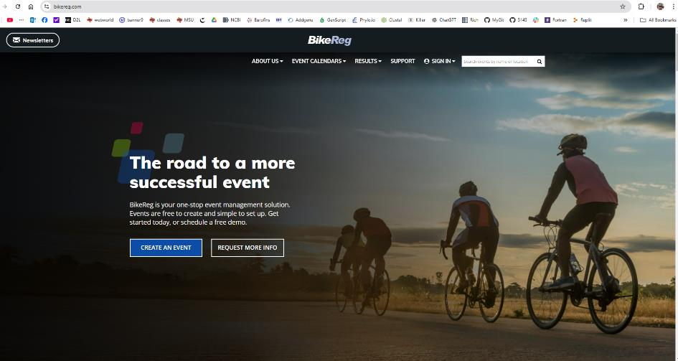
Participant registration
~80% of HHH participants pre-register via BikeReg.com
Remaining participants register onsite during the weekend of the events

Slide 46
Business domain: Recreation and leisure
Athletes
Amateur
Professional
Recreationalists
Casual
Extreme
Spectators
Venders
Clothing
Equipment/Gear
Nutrition/Health
Artwork/Memorabilia

Slide 47
Business domain: info 1
Jon Scales (team member) is also member of HHH steering committee

Slide 48
Business domain: info 2

Slide 49
Brainstorming 1

Slide 50
Brainstorming 2

Slide 51
Holy shit there are way tooooo many slides in this thing!!!

Slide 52
classifications

Slide 53
classifications
classes

Slide 54
classifications
classes

Slide 55
classifications
Attributes/values

Slide 56
classifications
Relationships
Association, inheritance

Slide 57
classifications
Relationships
aggregation

Slide 58
classifications
multiplicity

Slide 59
UML diagrams - Association

Slide 60
UML diagrams - aggregation

Slide 61
UML diagrams - inheritance

Slide 62
UML diagrams - multiplicity

Slide 63
Domain model
Integrate previous 4 slides

Slide 64
Version control
Link to git repository

Slide 65
team communication
Email/slack log

Slide 66
Accomplishments - jon

Slide 67
Accomplishments - Tim

Slide 68
Accomplishments - cooper

Slide 69
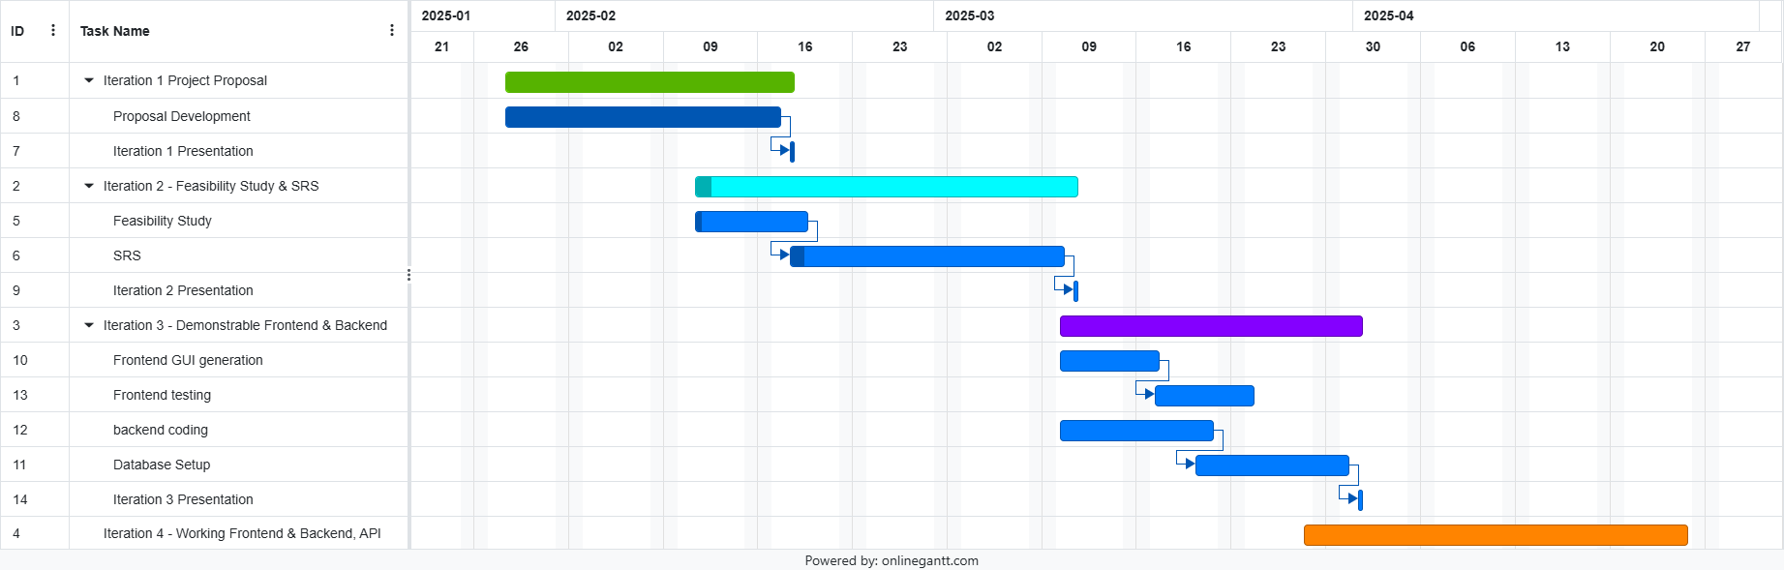
schedule

Slide 70
Finally - project demo
Embed video – open with vlc - we’ll have to record this via screencapture – OBS studio?

Slide 71
Iteration 3
Tim Haxton
Cooper wolf
Jon scales (Lead)

